Slide 1

LEDs and Classes
Lesson 25

Slide 2
What the Lesson Will Cover
Recap the role of the micro:bit pins
Know what a class is
Wire up an LED
Write a program to control the LED

Slide 3
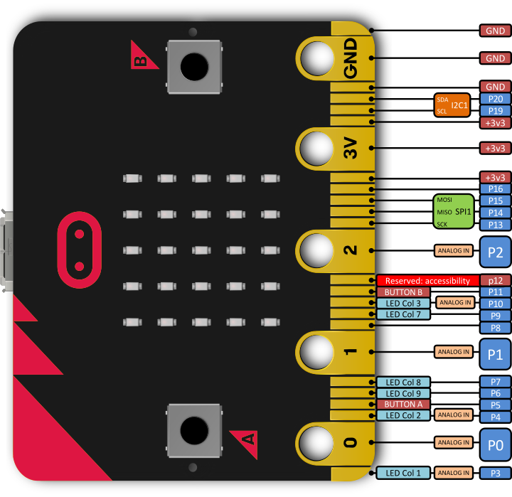
Remember the Pins From Lesson 5?
The pins enable you to add additional input, outputs and control to your micro:bit and programs
For example, you can attach a temperature sensor and write a program to respond to the readings
In this lesson you will use Pin 0 and the GND pin to turn an LED ON and OFF
LED – light emitting diode
Notes:
Discuss that the micro:bit has a number of pins, can the students locate them? Talk over some of the pins and what they do, the GND pin, power pins, input and output pins.
Recap from Lesson 5

Slide 4
Let’s Look At the Program First
from microbit import *
while True:
if button_a.is_pressed():
pin0.write_digital(1)
else:
pin0.write_digital(0)
Notes:
Discuss what the program does and what triggers the event, (Button a)
Explain that the pin0.write_digital(1) is part of a class
Learners could also identify the selection – lines 4 and 6
Inputs – line 3
Outputs – lines 3 and 6

Slide 5
Classes
Python is an object-oriented programming language (OOP)
Most of the code is implemented using classes
Programmers use classes to keep related content and things together
This is similar to keeping fruit in a fruit bowl – the fruit bowl is a class that contains lots of different, but related objects
The pin0.write_digital(1) is part of the microbit.MicroBitDigitalPin class and contains several other pieces of code to control and LED
Notes:
Explain what classes are, can Learners think of other everyday examples of classes? School class, pets, music, cheese,

Slide 6
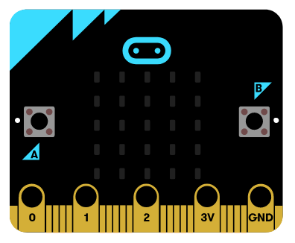
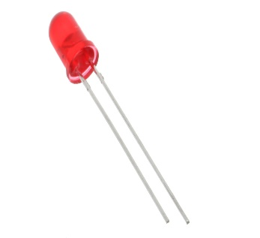
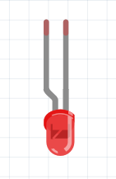
Wire Up the LED
Anode
Cathode
Notes:
Explain about the two different legs on an LED, the longer one is the positive leg, the anode and the shorter leg is the negative, the cathode.
It is essential that Learners get these round the correct way otherwise the LED can burn out.

Slide 7
Student Activity
Write up and download the torch program
Now try the Stretch Tasks:
Adapt the code so that Button B turns the LED ON
Edit the code so that the LED stays ON until Button B is pressed
Write a code so that the LED flashes, this uses ON and OFF and sleeps – see the example code below:
pin0.write_digital(1)
sleep(0.5)
pin0.write_digital(0)
Wire up two LEDs, one on Pin 0 and another on Pin 1, write the code for Button A to turn on the first LED and Button B to turn on the second
Notes:
Support Learners where required.

